Slide 1
Blockchain Introduction By Dr. Norman Guo

Slide 2

What is Blockchain
What is blockchain in your mind?

Slide 3
Blockchain Application
Blockchain Basic
Origin
Structures
Technologies
Revolutionary
Finance
Supply Chain

Slide 4
Blockchain Application
Blockchain Basic
Origin
Structures
Technologies
Revolutionary
Finance
Supply Chain

Slide 5
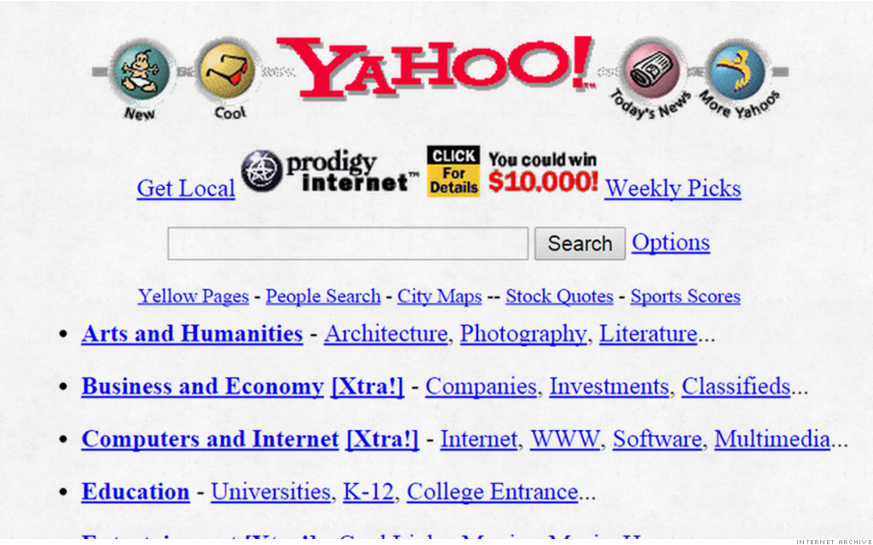
Internet of Information (Web 1.0)

Slide 6
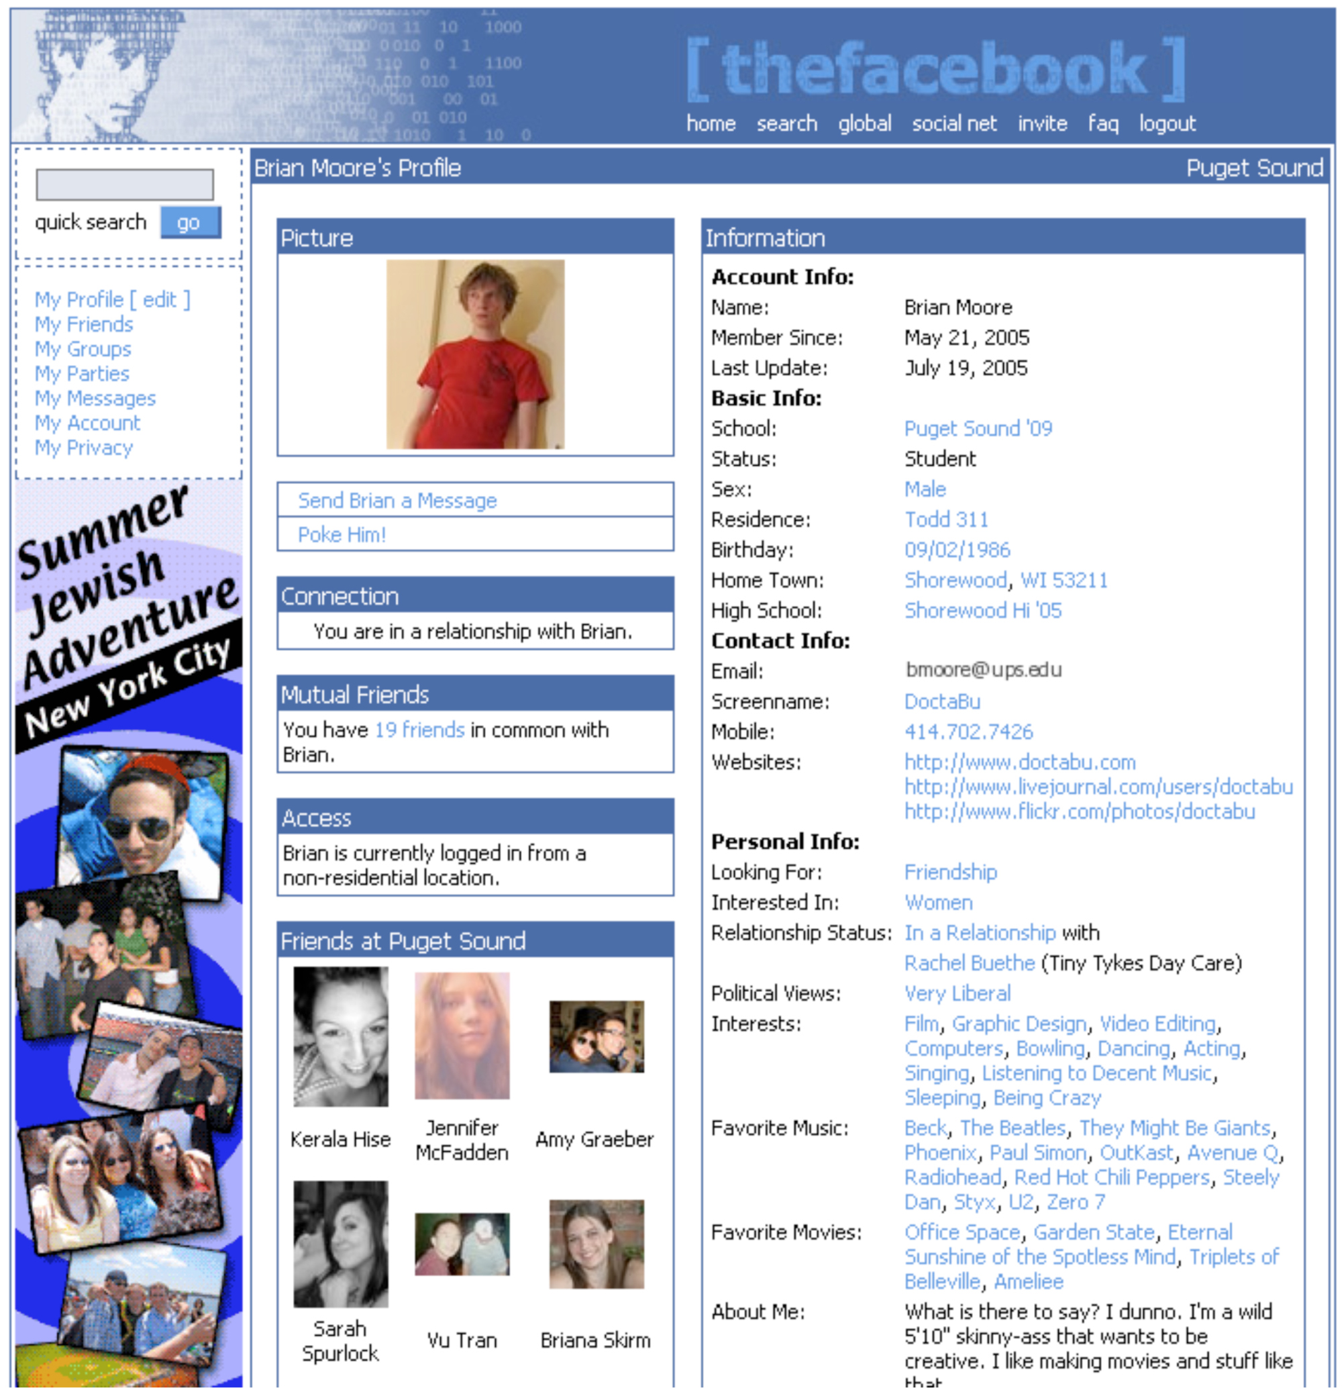
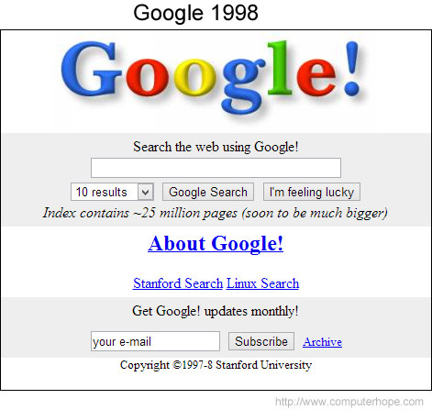
Internet of Information (Web 2.0)
Notes:
What is the concerns about such form of Internet?
Could you give us some examples?

Slide 7
Internet of Information
Limitation: Companies (banks or large tech companies) maintain its infrastructure and they extract a massive amount of data from us users
Exclusive
Data Privacy
Data Safety
Data Manipulation
Need a need protocol to regain the trust of information!

Slide 8
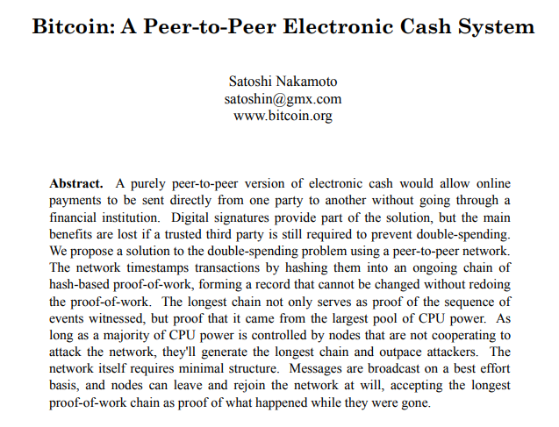
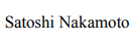
What is Blockchain
Released in October 2008
Anonymous

Slide 9
Blockchain Application
Blockchain Basic
Origin
Structures
Technologies
Revolutionary
Finance
Supply Chain

Slide 10
What is Blockchain
It’s a chain of block, or a digital distributed ledger

Slide 11
Blockchain Structure
Blockchain is a chain of blocks
Each block contains data, the hash, the hash of the previous block, and a pointer to the previous block
Prev. Hash
Prev. Hash
Prev. Hash
H( )
Data
Data
Data
Hash
Hash
Hash

Slide 12
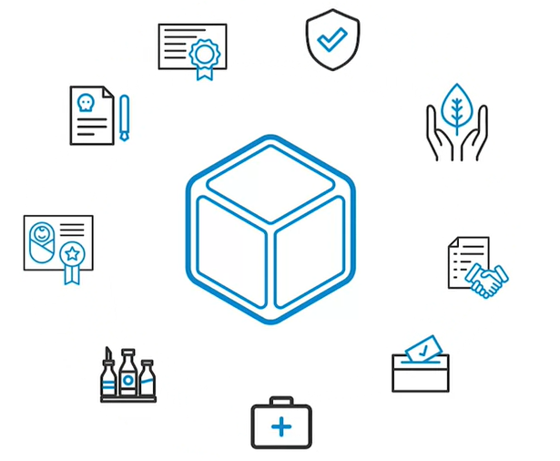
Blockchain Structure

Slide 13
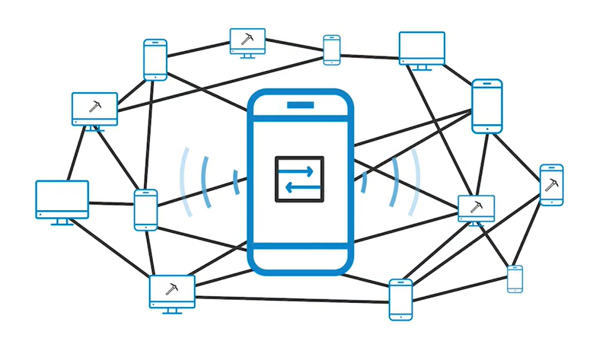
Blockchain Structure
It’s a digital distributed ledger

Slide 14
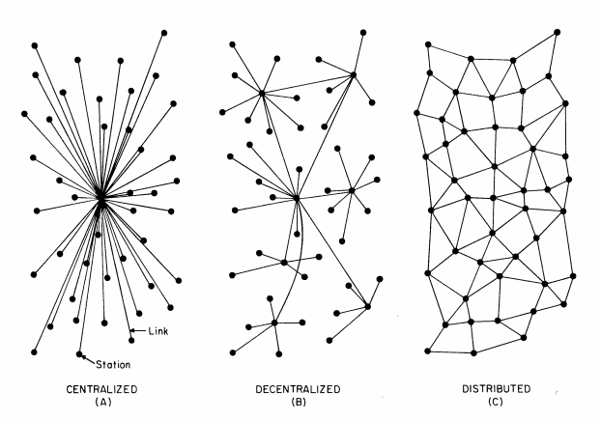
Blockchain Structure
It’s a digital distributed ledger

Slide 15
Blockchain Application
Blockchain Basic
Origin
Structures
Technologies
Revolutionary
Finance
Supply Chain

Slide 16
Basic Technologies
Hash Function
Digital Signature
Consensus mechanism
Public and Private Blockchain

Slide 17
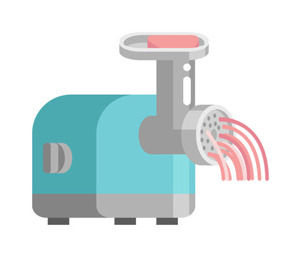
Basic Technologies – Hash Function
The Hash Function: A “one-way” function
Alice sent Bob 2.5 bitcoins
SHA-256
f1e7decf894e3fd8eb182f247fa13bfe82a0d667d3c91fe8f307c3b43b329960
Demo

Slide 18
Basic Technologies – Hash Function
If someone changes any part of a blockchain, then it is infeasible to make the chain consistent without changing the head pointer
One only need to check the head pointer to detect the tampering
Prev: H( )
Prev: H( )
Prev: H( )
Prev: H( )
H( )
Data
Data
Demo
Data
Data
Notes:
Password Storage as one of the application

Slide 19
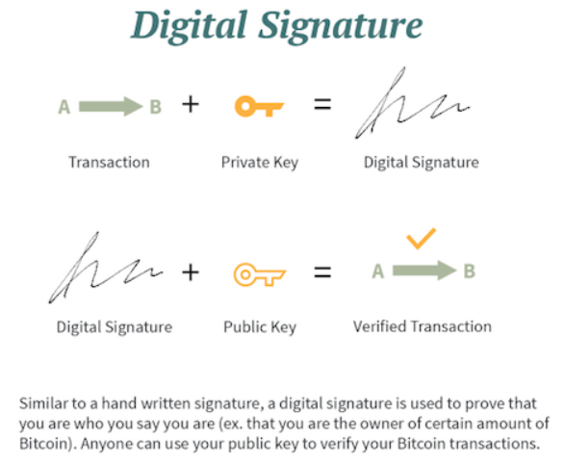
Basic Technologies – Digital Signature
Demo

Slide 20

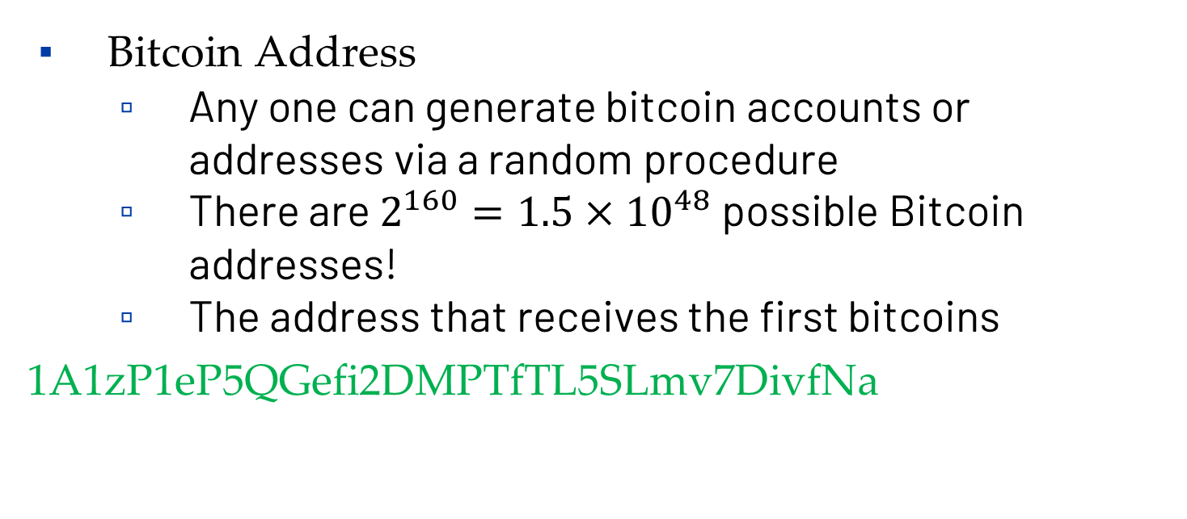
Basic Technologies – Digital Signature
Bitcoin Address
Any one can generate bitcoin accounts or addresses via a random procedure
There are $2^{160}=1.5×{10}^{48}$ possible Bitcoin addresses!
The address that receives the first bitcoins
1A1zP1eP5QGefi2DMPTfTL5SLmv7DivfNa

Slide 21
Basic Technologies – Consensus Mechanism
How do blockchain nodes agree like a big, happy family?
Proof of work (mining)
Proof of stake (staking)
Proof of authority

Slide 22
Basic Technologies – Consensus Mechanism
Proof of Work
The miners compute the hash of block in progress together with a nonce, a fixed-length number
Source: King, Williams and Yanofsky (2013)

Slide 23
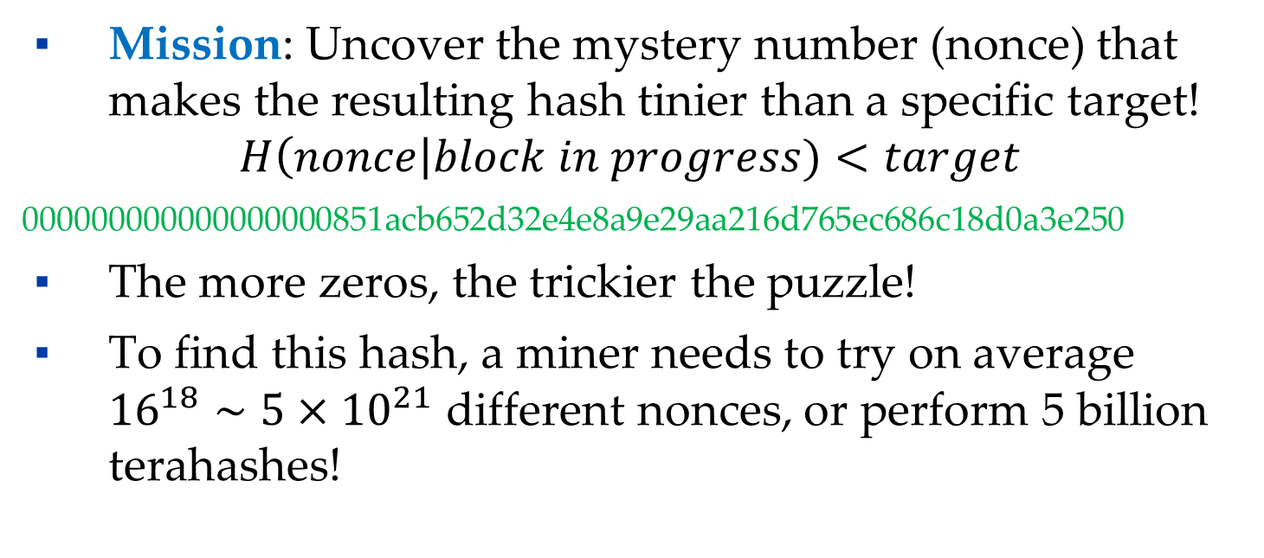
Basic Technologies – Consensus Mechanism
Proof of Work
Mission: Uncover the mystery number (nonce) that makes the resulting hash tinier than a specific target!
$$H\left(nonce\right|block in progress)<target$$
000000000000000000851acb652d32e4e8a9e29aa216d765ec686c18d0a3e250
The more zeros, the trickier the puzzle!
To find this hash, a miner needs to try on average ${16}^{18}∼5×{10}^{21}$ different nonces, or perform 5 billion terahashes!

Slide 24
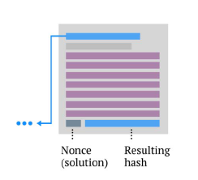
Basic Technologies – Consensus Mechanism
Proof of Work
When a miner finds a nonce that solves the problem, he/she wins the block and broadcasts the solution to the network
Demo

Slide 25
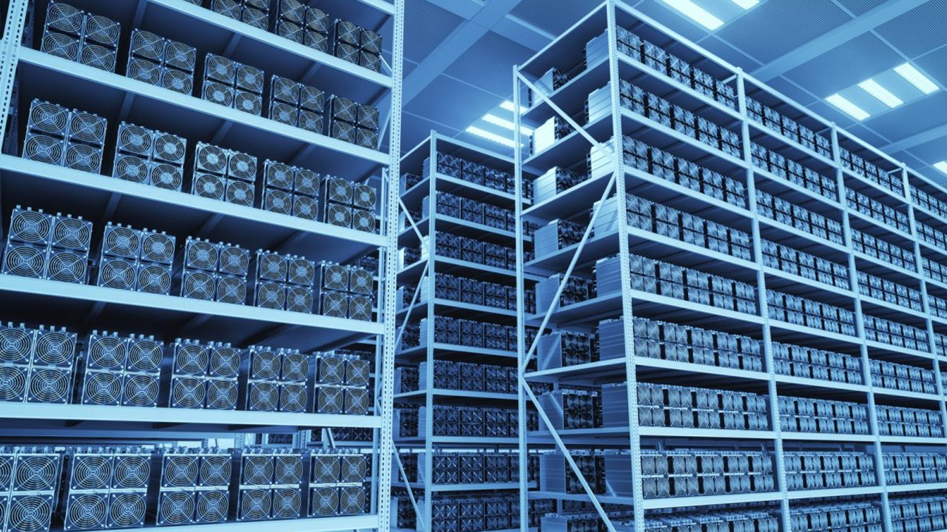
Basic Technologies – Consensus Mechanism

Slide 26
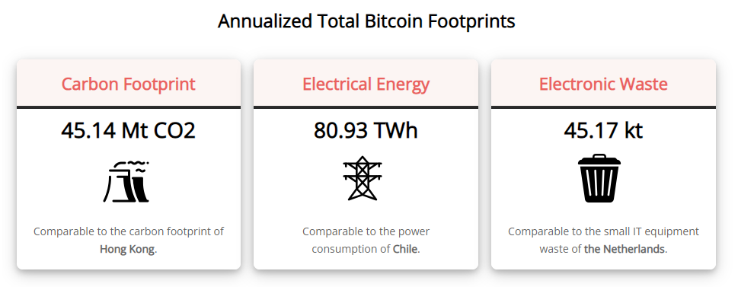
Basic Technologies – Consensus Mechanism
Proof of Work
Energy Consumed is Unsustainable

Slide 27
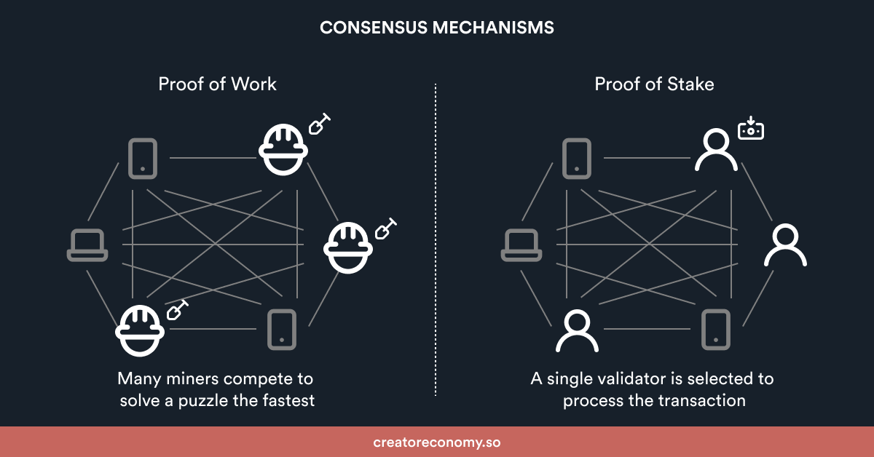
Basic Technologies – Consensus Mechanism
Proof of Stake

Slide 28
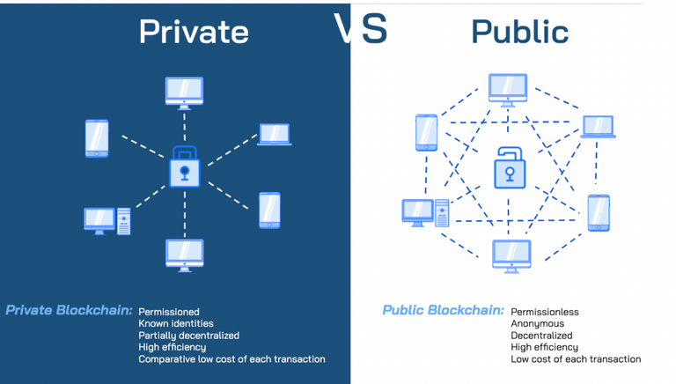
Basic Technologies – Public & Private Blockchain

Slide 29
Blockchain Application
Blockchain Basic
Origin
Structures
Technologies
Revolutionary
Finance
Supply Chain
Notes:
Traditional Systems: Centralized, modifiable, and require intermediaries
Blockchain Systems: Decentralized, immutable, and eliminates intermediaries

Slide 30
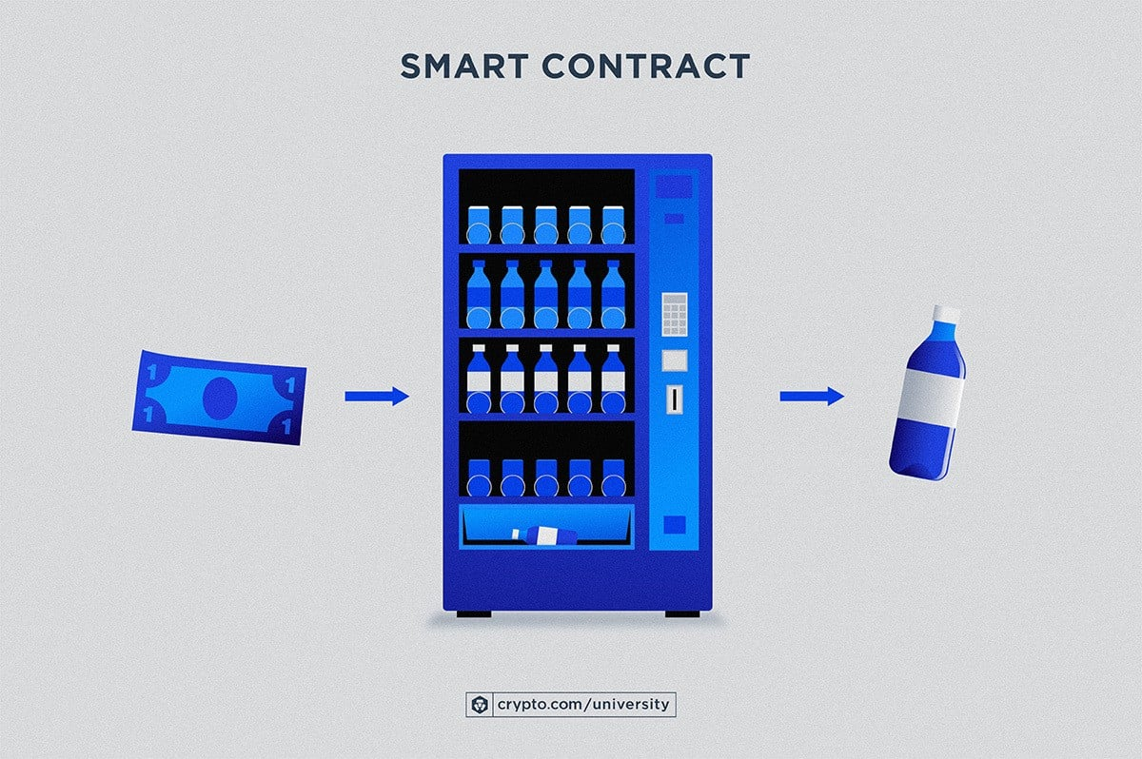
Basic Technologies – Smart Contract
Notes:
Accessible to everyone
No middlemen required
Auto execution
Stored in secure lockbox
Run on computer logic

Slide 31
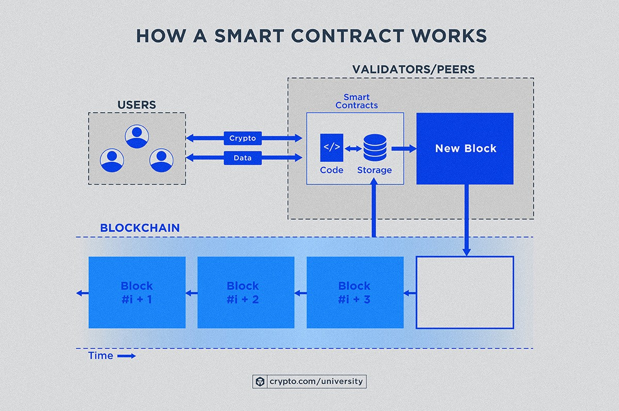
Basic Technologies – Smart Contract
Self-executing computer program that runs on a blockchain
Notes:
Benefits of smart contracts over traditional automation: Trustless execution, immutability, efficiency, lower costs, security, and interoperability

Slide 32
Features of Blockchain
Decentralized
Proof of work or other consensus mechanism
Better Security
Hash, Function, Distributed Ledger
Faster Settlement
24/7 without intermediary

Slide 33
Blockchain Application
Blockchain Basic
Origin
Structures
Technologies
Revolutionary
Finance
Supply Chain

Slide 34

Crypto Investment 2022
Source: btctwitter

Slide 35
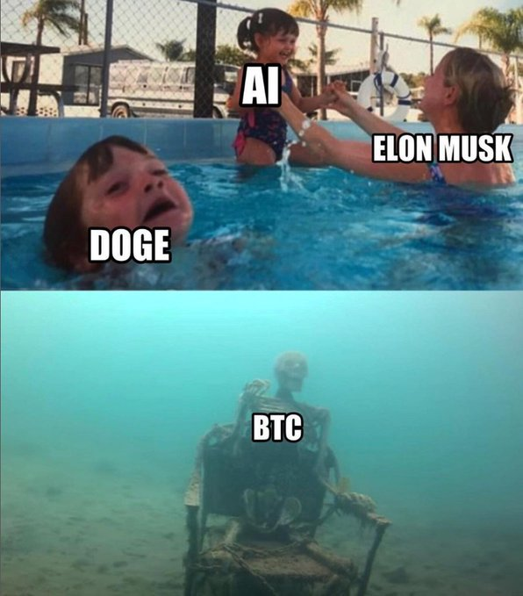
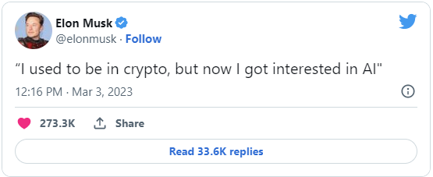
Elon Musk on Crypto

Slide 36
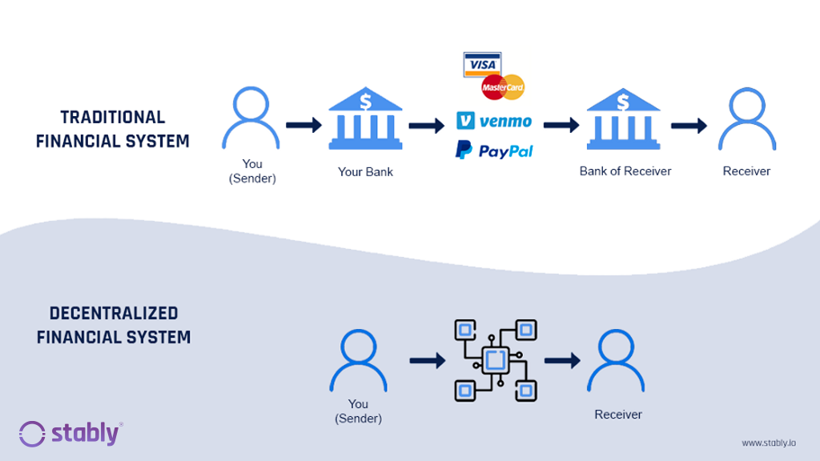
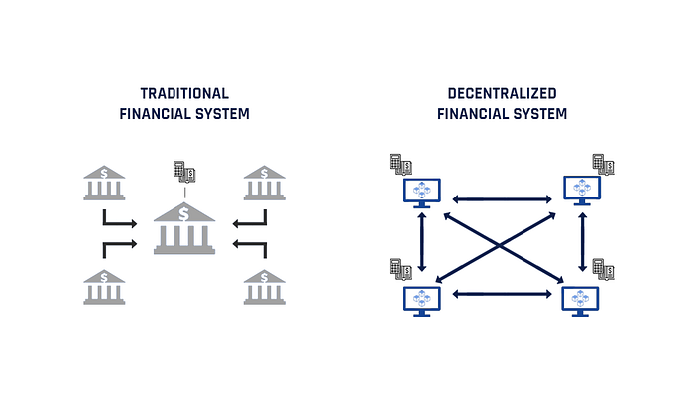
Decentralized Finance vs. Traditional Finance

Slide 37
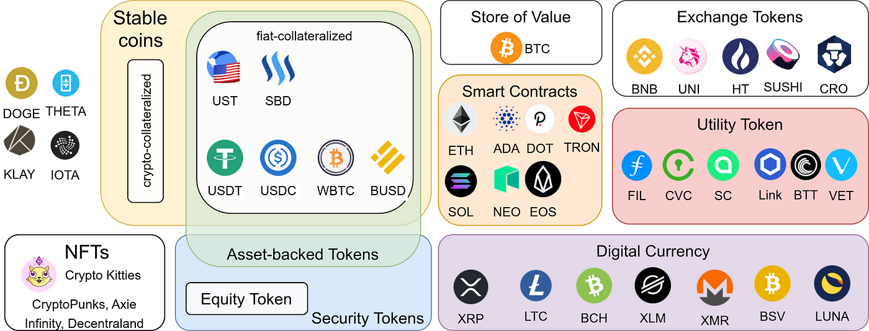
Tokenomics
Historical Trend
Current Rank

Slide 38
Types of Token
Payment Token
Utility Token
Security Token
Crypto-collectibles (NFT)
…

Slide 39
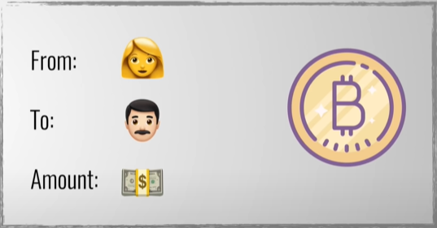
Payment Token
Bitcoin
A cryptocurrency that store the transaction data of bitcoin on the blockchain system

Slide 40

Payment Token
Bitcoin
Example: Alice finds irresistible goods from merchant Bob and sends him a shiny Bitcoin.
Alice
Bob
1 BTC

Slide 41
Payment Token
Bitcoin Transaction
Bob shares his public address with Alice via string or QR-code.
Alice enters Bob's address, the Bitcoin amount, and signs with her private key.
Alice broadcasts the transaction to the Bitcoin network—crypto magic!
Demo
Alice
Bob
1 BTC

Slide 42

Utility Token
Ethereum
Founded by Vitalik Buterin in 2014
The most popular smart contract platform
Home base for countless ICOs and decentralized applications (dApps) that cover finance, gaming, art, and more!

Slide 43
Utility Token
Ethereum
Tokens with specific powers inside a blockchain platform:
Unlock special features or services
Incentivize user contributions

Slide 44
Utility Token
BAT: The fastest ICO on Ethereum
Brave Browser – Basic Attention Token (BAT):
The ICO raised $36m via a token offering on the Ethereum Network. The offering raised 156,250 Ether in a mere 24 seconds!
The token can be used to obtain a variety of advertising and attention-based services on the Brave platform.
Notes:
https://basicattentiontoken.org/

Slide 45

DeFi (Decentralized Finance)
A financial system built on blockchain technology.
Bypasses traditional intermediaries (like banks).
Enables seamless, transparent, and secure financial services.
Example: Aave
A decentralized lending and borrowing platform.
Users can earn interest or borrow assets without banks.
Fully transparent and open-source.
Notes:
https://basicattentiontoken.org/

Slide 46

Crypto-collectibles (NFT)
Unique digital assets for digital or physical items:
Artwork, collectibles, or real estate
Built on platforms like Ethereum
Example:
CryptoKitties
Sandbox
CryptoPunk

Slide 47
Blockchain Application
Blockchain Basic
Origin
Structures
Technologies
Revolutionary
Finance
Supply Chain

Slide 48
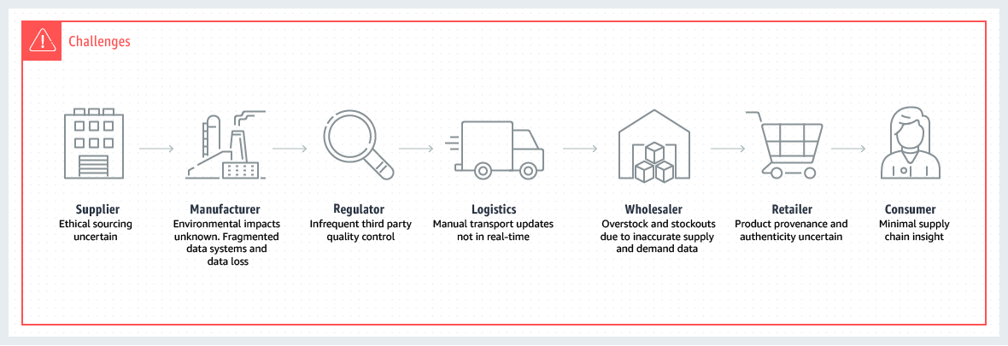
Challenges of Traditional Supply Chains

Slide 49
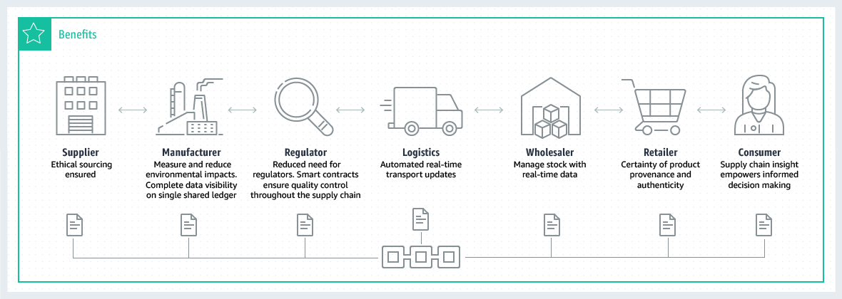
Benefits of Supply Chains with Blockchain

Slide 50
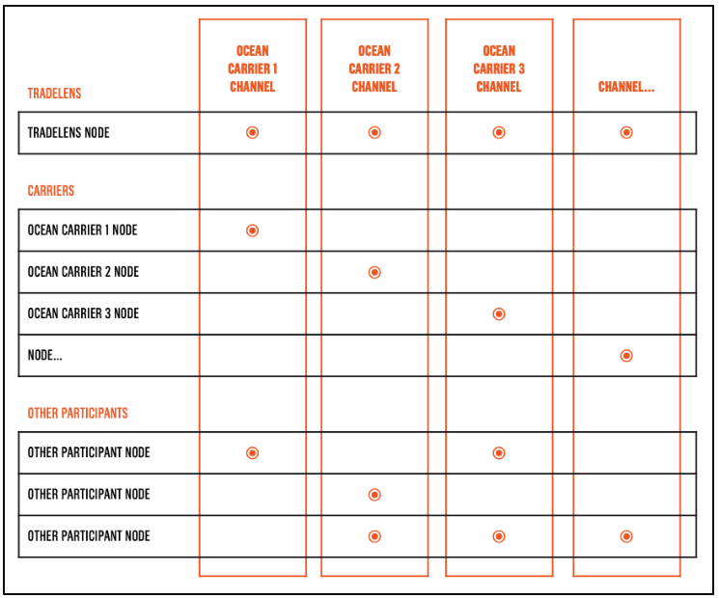
Application in Supply Chain

Slide 51

Industry Use Cases
Food and Agriculture
Food Safety
Access of the entire food product life cycle
Identify the source of contamination
Empower Customers and Sustainable Small Farmers
Allow small farmers to track their produce
Automation quicken the payment process
Connect customers directly with the source of food

Slide 52
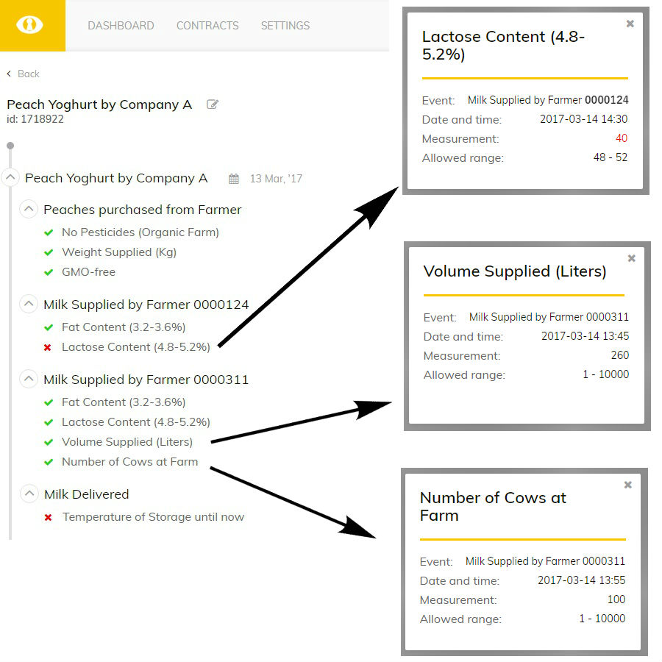
Industry Use Cases

Slide 53
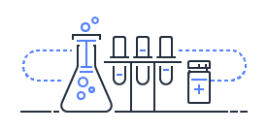
Industry Use Cases
Pharmaceuticals
Counterfeit Medicine
Check entire supply chain by serial numbers
Identify the weak points that present opportunity for counterfeit medicines
Medication Recalls
Identifying unsafe medications
Recalls associated with quality through automation

Slide 54
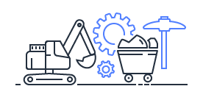
Industry Use Cases
Mining
Ethical Sourcing
Limit the opportunity for unethically sourced minerals like cobalt and tantalum to enter the supply chain
Ensure Authenticity
Ensure authentic and conflict free diamonds
Track record individual level details of the stone’s condition

